Slide 1

SECTION 2 Static Games of Complete Information
Class 10

Slide 2
Section 2 Static Games of Complete Information
REVIEW
Module 1: Introducing Games
Module 3: A Pure Strategy
Games vs. Decision Problems
Profiles: Strategy Profile → Payoff Profile
Complexity: Interactions
Information: External (Other players’ “decision problems”)
Strategic Thinking
Solution
In general:
Comprehensive
Pre-determined
Static Games:
One situation
Strategy = Action
What else?
Common knowledge of
Rationality
Strategic thinking: ‘If…then…’
Module 2: Static Games of Complete Information
Pure strategy
Static
No time component
One action per player
Simultaneous, at the same time
Independently, without knowledge of other player’s chosen actions
Complete Information
Common knowledge among all players:
Actions
Outcomes
Payoffs

Slide 3







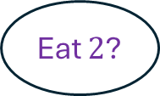


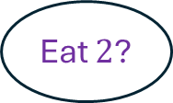




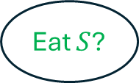



Pure Strategy in a Dynamic Game
REVIEW
$$1$$
Don’t eat $S$
Eat $S$
$$2$$
$$2$$
Don’t eat $S$
Eat $1$
Since this is a dynamic game, player 2 must have a plan of action ready for both his “decision problems.”
Don’t eat $1$
Eat $S$
$$3$$
$$3$$
Example of a pure strategy of player 2 (specified even before player 1 makes his decision):
Decision node #1: If Player 1 doesn’t eat S, then I’ll eat S.
Decision node #2: If Player 1 eats S, then I’ll not eat Player 1.
$$3$$
Terminal node
Eat $S$?
Eat $2$?
Eat $2$?

Slide 4
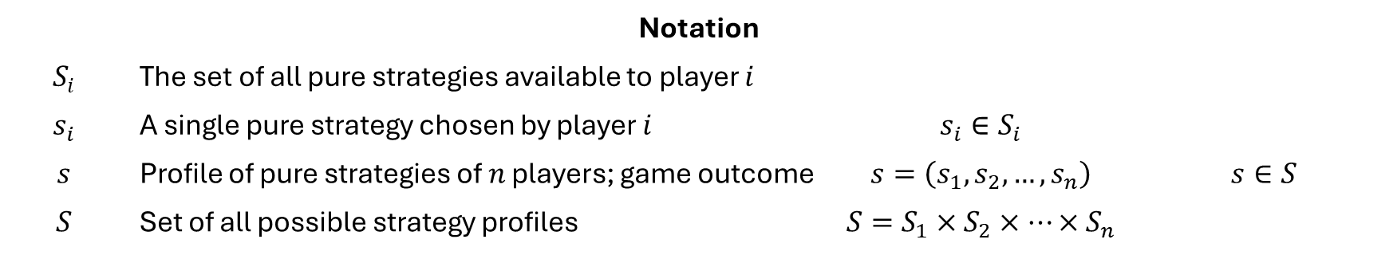
Section 2 Static Games of Complete Information
REVIEW
Notation
$$S_{i}$$ | The set of all pure strategies available to player $i$
$$s_{i}$$ | A single pure strategy chosen by player $i$ | $$s_{i}∈S_{i}$$
$$s$$ | Profile of pure strategies of $n$ players; game outcome | $$s=\left(s_{1},s_{2},…, s_{n}\right)$$ | $$s∈S$$
$$S$$ | Set of all possible strategy profiles | $$S=S_{1}×S_{2}×…×S_{n}$$

Slide 5

MODULE 4 Normal-Form Games with Pure Strategies
A Formal Framework to Represent Static Games of Complete Information
…the problem definition
…fitting a game into a well-defined structure
…solving the game

Slide 6

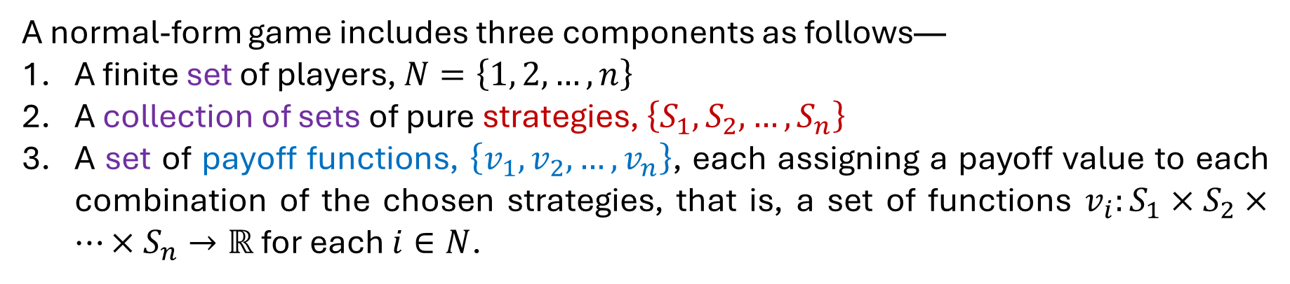
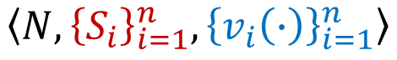
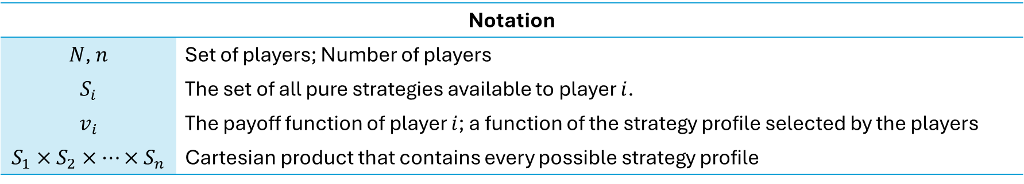
A Normal-Form Game
Static games → Normal-form representation
Dynamic games → Extensive-form representation (Game tree)
$$\left\langle N, {\left\{S_{i}\right\}}_{i=1}^{n},{\left\{v_{i}\left(∙\right)\right\}}_{i=1}^{n}\right\rangle$$
A normal-form game includes three components as follows—
A finite set of players, $N=\left\{1, 2, …, n\right\}$
A collection of sets of pure strategies, $\left\{S_{1}, S_{2}, …, S_{n}\right\}$
A set of payoff functions, $\left\{v_{1}, v_{2}, …, v_{n}\right\}$, each assigning a payoff value to each combination of the chosen strategies, that is, a set of functions $v_{i}:S_{1}×S_{2}×…×S_{n}→ℝ$ for each $i∈N$.
Strategy profile → Payoff profile
Notation
$N$, $n$ | Set of players; Number of players
$$S_{i}$$ | The set of all pure strategies available to player $i$.
$$v_{i}$$ | The payoff function of player $i$; a function of the strategy profile selected by the players
$$S_{1}×S_{2}×…×S_{n}$$ | Cartesian product that contains every possible strategy profile

Slide 7

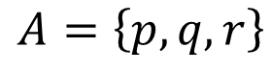
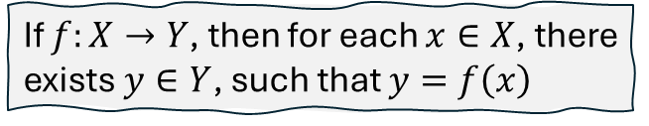
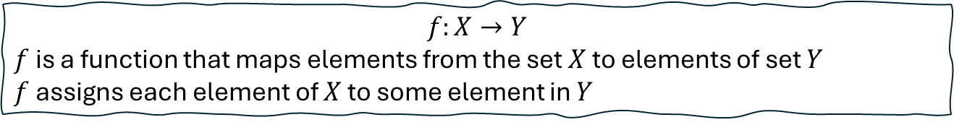
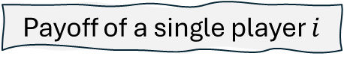
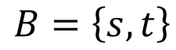
Cartesian Product of Sets
Player’s preferences over strategy profiles
MATH
A set
A set
Payoff of a single player $i$
$v_{i}:S_{1}×S_{2}×…×S_{n}→ℝ$ for each $i∈N$
The Cartesian product of two sets $A$ and $B$, denoted by $A×B$, defines a new set that includes all the ordered pairs $\left(a, b\right)$ such that $a∈A$ and $b∈B$.
$$f:X→Y$$
$f$ is a function that maps elements from the set $X$ to elements of set $Y$
$f$ assigns each element of $X$ to some element in $Y$
$$A=\left\{p, q, r\right\}$$
$$B=\left\{s, t\right\}$$
$$A×B=\left\{\left(p, s\right),\left(p, t\right),\left(q, s\right),\left(q, t\right),\left(r, s\right),\left(r, t\right)\right\}$$
If $f:X→Y$, then for each $x∈X$, there exists $y∈Y$, such that $y=f\left(x\right)$
If $S_{i}$ is the set of all possible strategies of player $i$ and there are $n$ players, then the Cartesian product of the strategy sets is the set…
Set of all possible strategy profiles (outcomes)
$$S=S_{1}×S_{2}×…×S_{n}=\left\{\left(s_{1},s_{2},…, s_{n}\right):s_{i}∈S_{i} for all i=1, 2, …, n\right\}$$
Strategy profile
Pure strategies
Strategy sets
Strategy profiles
Payoffs as functions of strategy profiles
Set of all strategy profiles
…such that

Slide 8
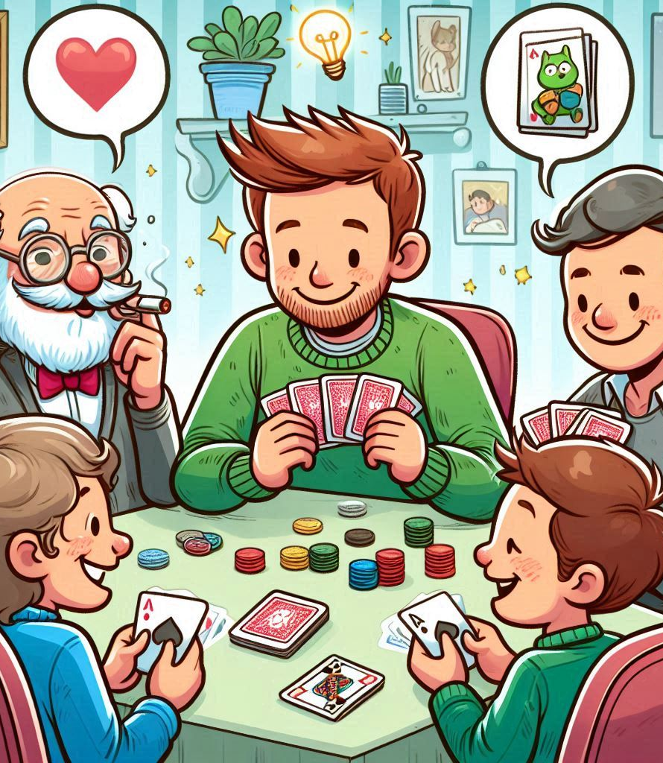

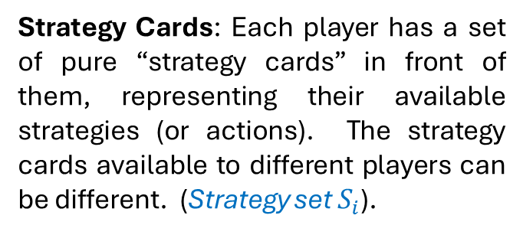
Game Logistics The Setup
Players: $n$ players sit at a table.
Strategy Cards: Each player has a set of pure “strategy cards” in front of them, representing their available strategies (or actions). The strategy cards available to different players can be different. (Strategy set $S_{i}$).
Visibility: The strategy cards for each player are placed face up, so everyone can see all players’ available strategies (complete information).

Slide 9
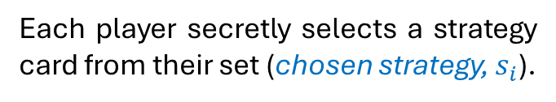
Game Logistics Choosing Strategies
Each player secretly selects a strategy card from their set (chosen strategy, $s_{i}$).
At this stage, players do not know which strategy cards the others have chosen (independent & simultaneous choices).

Slide 10
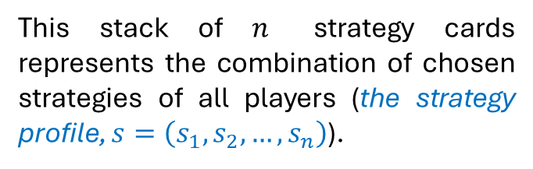
Game Logistics Simultaneous Reveal
All players simultaneously place their chosen strategy cards face up in the center of the table.
This stack of $n$ strategy cards represents the combination of chosen strategies of all players (the strategy profile, $s=\left(s_{1},s_{2}, …, s_{n}\right)$).

Slide 11
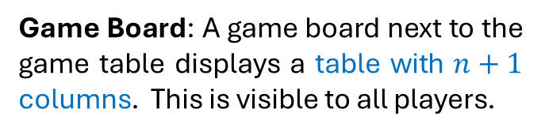
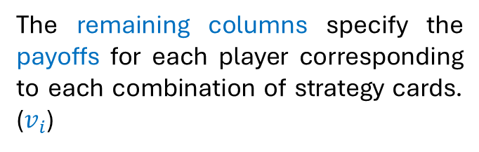
Game Logistics Payoffs
Game Board: A game board next to the game table displays a table with $n+1$ columns. This is visible to all players.
The first column lists all possible combinations of chosen strategy cards (strategy profiles)
The remaining columns specify the payoffs for each player corresponding to each combination of strategy cards. ($v_{i}$)
After consulting the game board, each player receives their payoff based on the revealed combination of strategy cards and the game ends.

Slide 12

MODULE 5 Matrix Representation of a Two-Player Finite Game
…a special case
Concise, Convenient, Clear

Slide 13
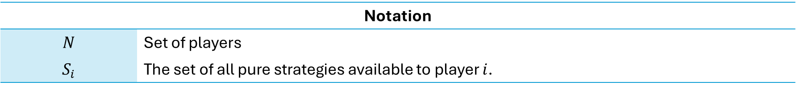
A Finite Game
A finite game is a game with a finite number of players, in which the number of strategies in $S_{i}$ is finite for all players $i∈N$.
Discrete strategy spaces
Notation
$$N$$ | Set of players
$$S_{i}$$ | The set of all pure strategies available to player $i$.

Slide 14

A Two-Player Finite Game
Mega-opponent
Less cumbersome
Focus on key concepts
Same principles apply to larger games
Linear Algebraic Equations
- Elimination Methods

Slide 15
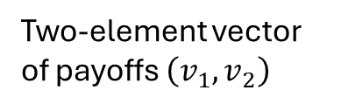
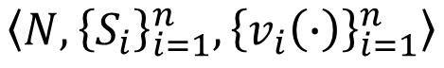
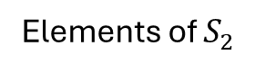
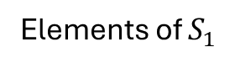
The Matrix Representation
Examples
Normal-form
Matrix-form
Solution
Human interactions
Player 2
Elements of $S_{2}$
Player 2’s pure strategies
Player 1
Elements of $S_{1}$
Common Knowledge
Player 1’s pure strategies
Two-element vector of payoffs $\left(v_{1},v_{2}\right)$
$$\left\langle N, {\left\{S_{i}\right\}}_{i=1}^{n},{\left\{v_{i}\left(∙\right)\right\}}_{i=1}^{n}\right\rangle$$
Each row-column combination represents a strategy profile
The normal-form representation
…?

Slide 16



MODULE 6 The Prisoner’s Dilemma
The Normal-Form Representation
(Discrete Strategy Spaces)
…a situation in which a difficult choice has to be made between two or more alternatives, especially ones that are equally undesirable.

Slide 17



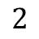
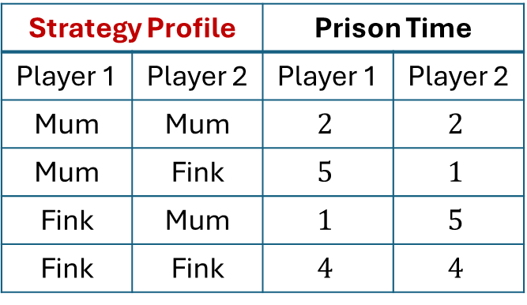
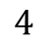
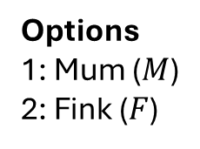
The Scenario
Strategic Interaction
EXAMPLE
One decision per player
Simultaneously
independently
Options
1: Mum ($M$)
2: Fink ($F$)
Prison Time
(Years)
Evidence
Major crime: Armed robbery
$$4$$
Minor crime: Petty theft
$$2$$
…unless at least one of you confesses
Interrogation Room #1
Interrogation Room #2
Strategy Profile |  | Prison Time
Player 1 | Player 2 | Player 1 | Player 2
Mum | Mum | $$2$$ | $$2$$
Mum | Fink | $$5$$ | $$1$$
Fink | Mum | $$1$$ | $$5$$
Fink | Fink | $$4$$ | $$4$$
Petty theft
$±1$ year for not cooperating/cooperating with police
Armed robbery

Slide 18
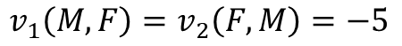
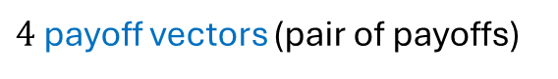
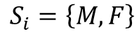
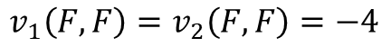
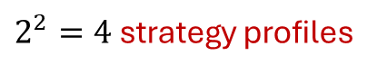
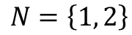
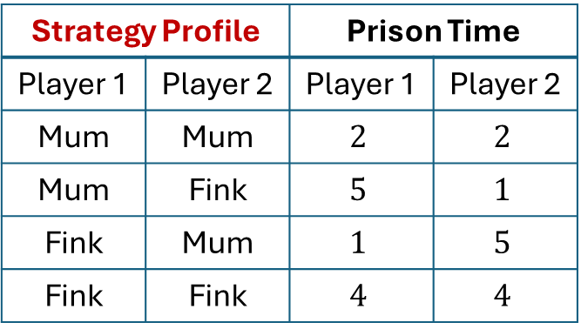
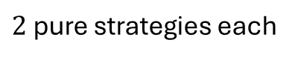
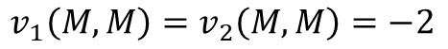
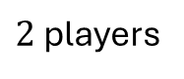
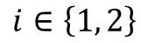
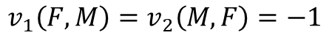
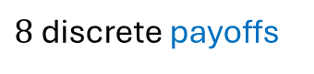
The Normal-Form Representation
Payoffs
Players
$$N=\left\{1, 2\right\}$$
Discrete strategies
Strategy Profile |  | Prison Time
Player 1 | Player 2 | Player 1 | Player 2
Mum | Mum | $$2$$ | $$2$$
Mum | Fink | $$5$$ | $$1$$
Fink | Mum | $$1$$ | $$5$$
Fink | Fink | $$4$$ | $$4$$
Strategy sets
$$S_{i}=\left\{M, F\right\}$$
for
$$i∈\left\{1, 2\right\}$$
Discrete
Payoffs
$$v_{1}\left(M, M\right)=v_{2}\left(M, M\right)=−2$$
$$v_{1}\left(F, F\right)=v_{2}\left(F, F\right)=−4$$
$$v_{1}\left(M, F\right)=v_{2}\left(F, M\right)=−5$$
$$v_{1}\left(F, M\right)=v_{2}\left(M, F\right)=−1$$
$2$ players
$2$ pure strategies each
$2^{2}=4$ strategy profiles
Payoffs as functions of strategy profiles
$4$ payoff vectors (pair of payoffs)
Preferences over outcomes: Negative of prison time
$8$ discrete payoffs

Slide 19
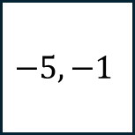

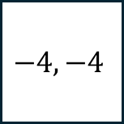


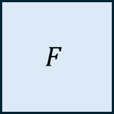

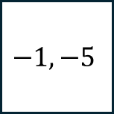
The Matrix Representation
Two-player finite game
Player 2
$$M$$
$$F$$
$$M$$
$$−2, −2$$
$$−5, −1$$
Player 1
$$F$$
$$−1, −5$$
$$−4, −4$$
All relevant information

Slide 20


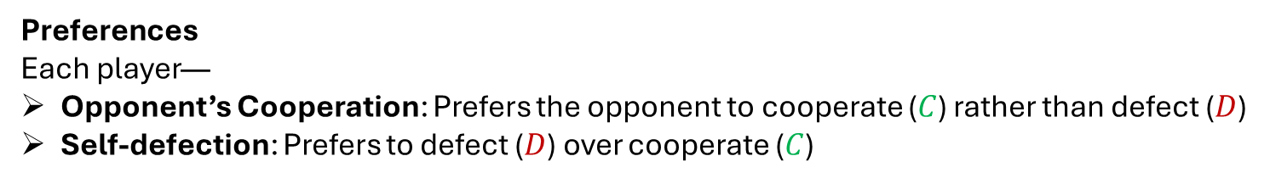






Game Structure
Player 2
$$M$$
$$F$$
$$M$$
$$−2, −2$$
$$−5, −1$$
Cooperation vs. Defection
The game models a situation in which each player—
Gains from cooperation
Player 1
$$F$$
$$−1, −5$$
$$−4, −4$$
Has a personal incentive to defect
Rationality leads to a suboptimal outcome
Preferences
Each player—
Opponent’s Cooperation: Prefers the opponent to cooperate ($C$) rather than defect ($D$)
Self-defection: Prefers to defect ($D$) over cooperate ($C$)
Ranking of Outcomes
$$\left(D, C\right)≻\left(C, C\right)≻\left(D, D\right)≻\left(C, D\right)$$

Slide 21

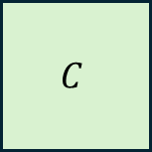
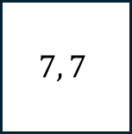

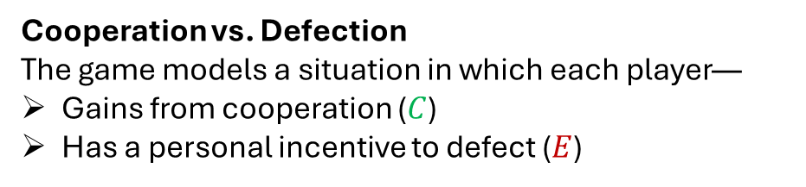
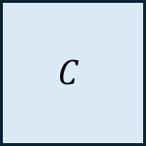

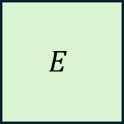

Another Prisoner’s Dilemma Restaurant Dilemma
EXAMPLE
simultaneously
Two friends go to a restaurant and decide whether to order a cheap ($C$) or an expensive ($E$) meal. The cheap meal costs $10$ and the expensive meal costs $20$. They will split the total bill equally. Each friend values the cheap meal at $17$ and the expensive meal at $25$.
Cooperation vs. Defection
The game models a situation in which each player—
Gains from cooperation ($C$)
Has a personal incentive to defect ($E$)
Player 2
$$C$$
$$E$$
Rationality leads to a suboptimal outcome
$$C$$
$$7, 7$$
$$2, 10$$
?
?
Player 1
$$E$$
$$10, 2$$
$$5, 5$$
?
?

Slide 22









Another Prisoner’s Dilemma Duopoly
EXAMPLE
Two firms produce the same good and must choose between high ($H$) and low ($L$) pricing.
Cooperation vs. Defection
The game models a situation in which each player—
Gains from cooperation ($H$)
Has a personal incentive to defect ($L$)
Player 2
$$H$$
$$L$$
Rationality leads to a suboptimal outcome
$$H$$
$$10, 10$$
$$−2, 12$$
Player 1
$$L$$
$$12, −2$$
$$6, 6$$

Slide 23









Another Prisoner’s Dilemma Working on a Joint Project
EXAMPLE
Two friends working on a joint project face a strategic decision: work hard ($W$) or goof off ($G$). Each prefers to let the other work hard while they goof off but dislikes being exploited by working hard when the other goofs off. Mutual effort is better than mutual slacking, but the incentive to free-ride creates a conflict.
Cooperation vs. Defection
The game models a situation in which each player—
Gains from cooperation ($W$)
Has a personal incentive to defect ($G$)
Player 2
$$W$$
$$G$$
Rationality leads to a suboptimal outcome
$$W$$
$$2, 2$$
$$0, 3$$
Player 1
$$G$$
$$3, 0$$
$$1, 1$$

Slide 24



Jungle Treasure
SHARE
TAKE
REVIEW
20
YOUR TURN
In the Google Form—
Question 1: Secretly choose SHARE or TAKE.
Question 2: Briefly explain why your choice is the better option.
Your choice will be randomly paired with a classmate’s response.
The Outcomes (…after collecting the two cards)
If both of you write SHARE, then the treasure is split equally.
If one writes SHARE and the other writes TAKE, the person who wrote TAKE gets the whole treasure, while the one who wrote SHARE gets nothing.
If both of you write TAKE, you’ll each get only a quarter of the treasure, and the wise old man keeps the remaining half.

Slide 25
MODULE 7 Battle of the Sexes
The Normal-Form Representation
(Discrete Strategy Spaces)

Slide 26




The Scenario: Alex & Chris
EXAMPLE
Where to meet this evening?
Option 1: At the opera
Option 2: At the football game
Simultaneously & Independently
Opera
Both players prefer being together over not being together.
Chris
Alex prefers the opera.
Alex
Chris prefers football.
Football

Slide 27











The Normal-Form Representation
Players
$$N=\left\{1, 2\right\}$$
Player 1: Alex
Player 2: Chris
Strategy sets
$$S_{i}=\left\{O, F\right\}$$
for
$$i∈\left\{1, 2\right\}$$
Payoffs
$$v_{1}\left(O, O\right)=3$$
$$v_{2}\left(O, O\right)=2$$
Payoff of $+2$ for being together
Payoff of $+1$ for being at preferred venue
Payoff of $+2$ for being together
$$v_{1}\left(F, F\right)=2$$
$$v_{2}\left(F, F\right)=3$$
Preferred
$$v_{1}\left(O, F\right)=1$$
$$v_{2}\left(O, F\right)=1$$
Different venues
Not Preferred
$$v_{1}\left(F, O\right)=0$$
$$v_{2}\left(F, O\right)=0$$

Slide 28






The Matrix Representation
Two-player finite game
Player 2
$$O$$
$$F$$
$$O$$
$$3, 2$$
$$1, 1$$
Player 1
$$F$$
$$0, 0$$
$$2, 3$$
All relevant information

Slide 29







Game Structure
Player 2
$$O$$
$$F$$
$$O$$
$$3, 2$$
$$1, 1$$
A Coordination Problem
The game models a situation in which each player—
Agrees that cooperation is better than non-cooperation
Player 1
$$F$$
$$0, 0$$
$$2, 3$$
Disagrees on what cooperation should look like
…compromise to preserve cooperation
Coordinating decisions: Resolving internal disagreements within a group united by a common theme or ideology
Lunch break on Day 4 of a test match
- To declare or not to declare

Slide 30








The United Front
EXAMPLE
Two politicians from the same party must each decide between two stances on an issue. Their goal is to present a united position to avoid confusing voters. Both officials agree that having the same stance is better than taking different stances. However, they disagree on which stance is preferable, as each has a personal favorite. If they take different stances, voters become uncertain, leading to the worst outcome for both officials.
Player 2
$$Y$$
$$N$$
$$Y$$
$$3, 2$$
$$1, 1$$
Player 1
$$N$$
$$0, 0$$
$$2, 3$$

Slide 31




Technology Integration
EXAMPLE
Two merging firms must choose a common technology to use as a unified entity. Each firm prefers to stick with its existing technology but agrees that adopting a single system is better than operating with different ones. Disagreement on the choice of technology leads to inefficiency, resulting in a worse outcome for both.
Player 2
$$Win$$
$$Mac$$
$$Win$$
$$3, 2$$
$$1, 1$$
Player 1
$$Mac$$
$$0, 0$$
$$2, 3$$

